Slide 1
IoT Practice-III Raspberry Pi 3 B as IoT Gateway (Embedded System)

Slide 2
Agenda
Introduction to Embedded System
Embedded Platform
ARM Processor
Linux
System Development (ARM+Linux)
Bootloader
Kernel Configuration
File System (Ramdisk)
Module Programming
Device Driver

Slide 3
Introduction to Embedded System

Slide 4
What’s Embedded System ?
All kinds of digital systems embedding micro-processor
performing the functions specific to an application.
optimized to the specific design goal.
Comparison with the conventional system
Stand-alone computer vs. Computer embedded in Product
General Purpose Computer vs. Special Purpose Computer

Slide 5
Why Embedded System ?
Paradigm of digital system design paradigm has changed rapidly.
High performance
Flexibility for adopting rapid upgrading& updating)
H/W-Only
(ASIC)
H/W-SW Co-design
S/W-Only
Standalone
(Firmware)
OS-Mounted
Complicated Function
Multitasking
Various types of networking
Efficient HW resource management

Slide 6
Design Aspects of Embedded System
Design goal
High performance : real-time operation is required
Flexibility : easy to modify & upgrade.
Design methodology
A co-design of hardware and software to perform the specific function optimally.
Difficulty
Not easy to co-design HW & SW
Requires high-level design expertise

Slide 7
Design Considerations
Resource limitation
Constrained memory usage
Software customization : reduction of code size, high performance coding
Portability
Small-sized : small packages
Battery operated : low power consumption
Short life-cycle of product
Easy to upgrade : flexible system
Low cost
Low material cost : survey on available chips, maintain supply-chain
Low design cost : design automation
Design goal of : Trade-offs between design considerations

Slide 8
Construction of Embedded System
Hardware components
Processor
Peripheral devices
Embedded hardware platform = Processor + Peripherals
Software components
System software
Middle-ware
Application software
Development tools

Slide 9
HW Components - Processor
Micro processing unit (MPU)
Computation-bound
Micro controller unit (MCU)
Control-bound
Digital signal processor (DSP)
Specialized for processing digital signals such as audio, video, …
Application specific processor (ASP) :
Java processor
Network processor
Crypto processor
Reconfigurable processor

Slide 10
HW Components – Peripherals
Peripheral devices
Perform a special I/O function or data processing task in order to speed up overall system’s throughput & reduce CPU’s load.
ASSP device
Off-the-shelf product designed to perform a specific function.
network controller, video codec, USB controller, etc
ASIC device
Self-developed, field-programmed
High-cost & high-speed
Fully customized

Slide 11
SW Components
System software
Operating system
Device driver
Middle-ware
Application specific libraries
Multimedia, Java, etc
Application software
What you want to do

Slide 12
Development Tools
SW Development tools
Compiler, linker, debugger, std. library,
In-system programmer
HW development tools
PCB artwork & analysis : thermal, vibration, fatigue life, convective air flow, stress, harness
Commercial vs. Free-ware
Development cost
Technical support
Continuous maintenance
Reliability

Slide 13
Theoretical Flow of Co-Design
System Specification
Automated Design
System Description Language
Design Cost Prediction
& Design Space Exploration
Cost function
Partition
Design constraints & Operating condition
Hardware Description Language
High-level Programming Language
Co-simulation
Hardware Synthesis
Compilation
Co-verification
RTL description
Machine code
ASIC
NV memory (Code)
SoC, SoB
uP + Memory + I/O’s

Slide 14
Practical Flow of Co-Design
Design Specification
Partition
Designer’s Expertise
& Intuition
HW
SW
Micro-Processor Selection
Bootloader/Startup
OS-mount
Standalone
Peripheral Devices Selection (ASIC/ASSP)
OS Kernel
Customization
Application
HW Platform Design
Device Driver
Application

Slide 15
Embedded Platform

Slide 16
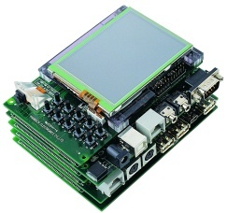
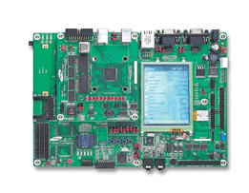
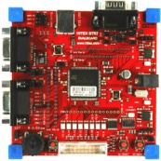
Embedded Platform
The base platform in which HW and SW components are integrated.
Self-developed or ready-made

Slide 17
Hardware Platform Design
Embedded processor selection
Processor type : MPU, MCU, DSP, ASIP
Instruction set architecture : RISC, CISC
Processor architecture
Von Neumann, Harvard
DSP-features : Dual-memory access, MAC, Floating-point
Memory : Flash, DRAM/SRAM
Application specific peripheral devices
On-chip : integrated in processor
Off-chip
Rapid prototyping : EPLD, FPGA, ….
ASSP : Ethernet, USB, PCMCIA, LCD, Audio codec, Touch-screen, ….
Hardware implementation
System-on-Board (SoB) : On-PCB
System-on-Chip (SoC) : One-Chip
I/O
I/O
I/O
ROM
RAM
Micro-processor
SoB/SoC

Slide 18
Embedded Processor
Intel
x86 (386, 486, Pentium)
ARM
ARM7, ARM9, StrongARM, ARM10, ARM11
Motorola
PowerPC, 68K / ColdFire, Mcore, Dragon Ball
MIPS Technologies
MIPS32 4K, 5K
Hitachi
Super-H (SH-1, SH-2, SH-3, SH-4, SH-5)
Texas Instrument
TMS320 (DSP), TMS370 / MSP430 (MCU)

Slide 19
Typical Design Procedure of Embedded System
Prepare boot-up program
Initialize the hardware : POST, setup parameters, checking its functionality.
Boot operating system
Select operation system
customize OS kernel
Setup the development environment
Tool chain : Compiler / Debugger / In-circuit programmer
Processor-dependent
Develop device drivers if need.
depends on OS & the types of peripheral devices
Read-made or self-developed

Slide 20
Typical Design Procedure of Embedded System
Check Libraries, APIs
Middle ware
Functional libraries for the specific application domain
Support application software development
Human interface : CLI (command-line interface) or GUI
Program Application Software
Handheld devices : PDA, Cellular/Smart phone, MP3 Player, PMP, Game console
Internet appliances,
Factory automation, Office automation
Automotive appliance : Car navigation, ECU
Ubiquitous, wearable computing
Sensor network

Slide 21
Embedded Operating System
Needs for OS
Multitasking
High-functionalities
Networking & support multimedia
Limitation of sequential programming
Support & manage various types of i/o devices
Rapid development and Maintenance
Easy to modify & download SW for changing new requirements from user & market
Provide new creative & high-quality solutions in time

Slide 22
Embedded Operating System
Linux
Window CE Embedded
VxWorks / pSOS : real-time OS
PalmOS : PDA
NetBSD : used widely for comm. system
eCOS : open source. Non-linux
Commercial vs. Free
License policy

Slide 23


ARM + Linux Platform
Most widely used embedded platform
Processor : ARM processor
OS : Linux
Legendary platforms
Assabet : Intel SA-1110 evaluation board
LART (Linux Advanced Radio Terminal) : Delft Univ. of Tech. (Netherlands)
PLEB : Univ. of New South Wales (Australia)
Itsy : DEC (Compaq) Western Research Lab
NetWinder : Corel Computer
Others

Slide 24
ARM Processor
32-bit processor families from ARM Inc.
Low-power / High-performance
The most widely used 32-bit micro-processor
ARM : www.arm.com
ARM : Advanced RISC Machine
Established in 1990.11 as joint venture (England)
Fund : Apple Computer, VLSI Technology
Technology : Acorn Computer Group
Provide IP (Intellectual Property) of ARM ISA

Slide 25
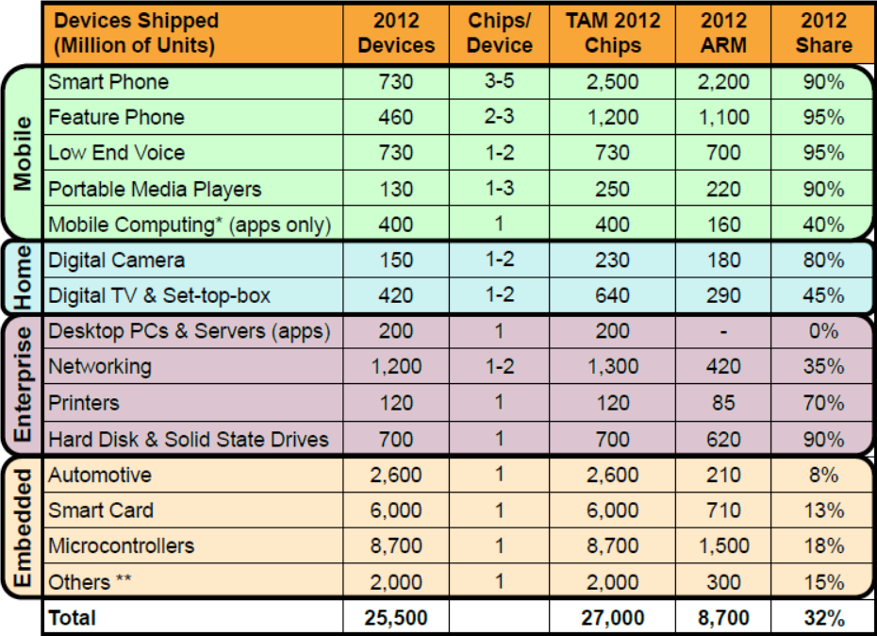
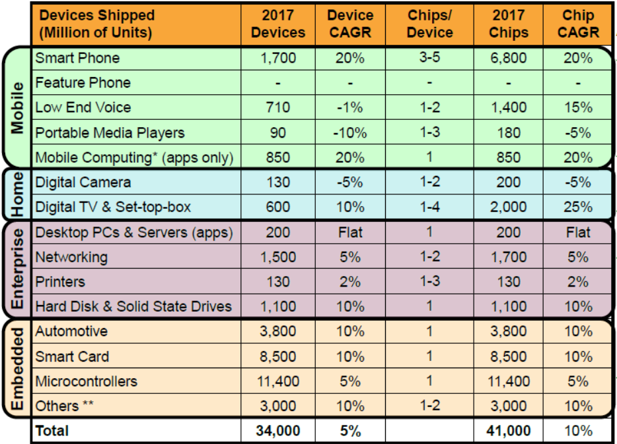
ARM Processor
Markets for ARM in 2012 & 2017
CAGR : Compound Annual Growth Rate

Slide 26
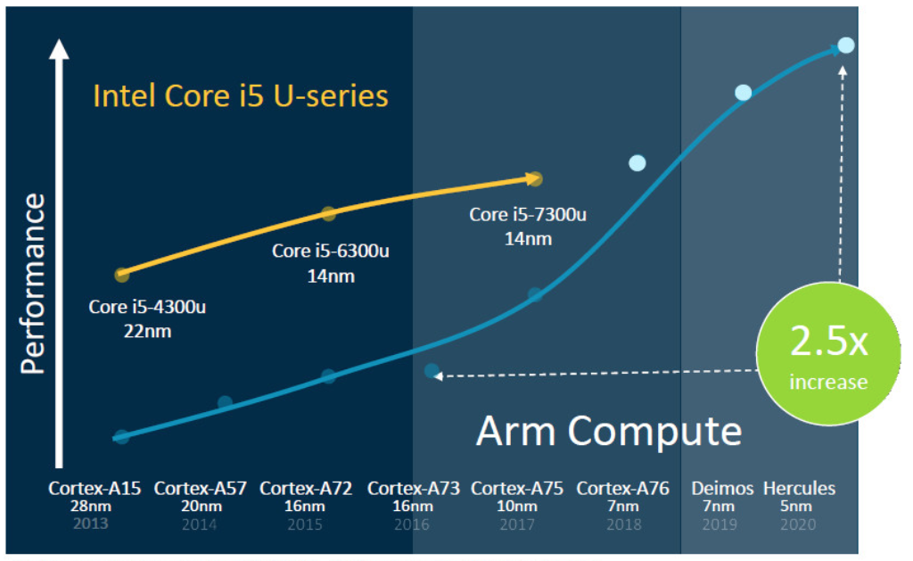
ARM Processor
Single-core performance based on SPECINT2k6.

Slide 27
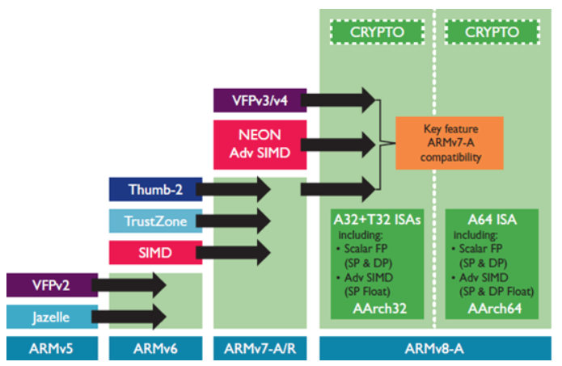
ARM Processor
ARM instruction set architecture

Slide 28
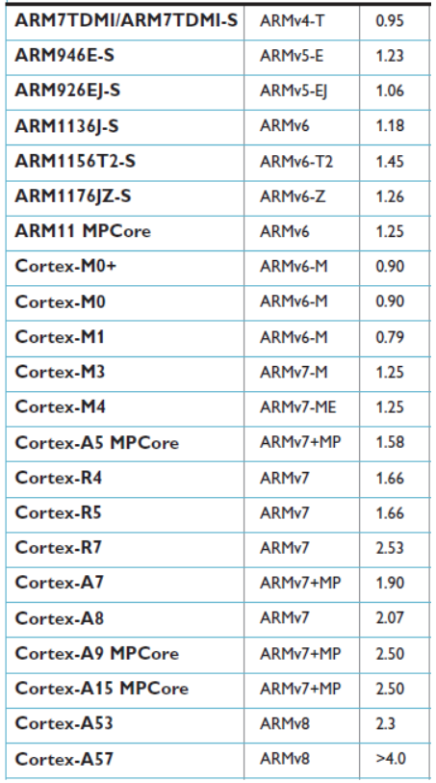
ARM Processor
Performance of ARM family in DMIPS/MHz

Slide 29
Linux
Linux overview
Started by Linus B. Torvals
A clone of UNIX
Free : Copyright → Copyleft
Kernel release
First version : 0.01, (1991)
www.kernel.org
Numbering Linux version
(major).(minor).(patch level)
Minor :
Even : stable release
Odd : development release
Latest stable version : 2.6.28

Slide 30
Linux
Strong point
Free : Open source, low design cost
Open architecture : support various processor
Large development people
Short development time
Easy to obtain device drivers
Stable : UNIX clone
Weak point
Difficult to design
Weak to GUI, Web brwosing, multimedia function

Slide 31
ARM Processor

Slide 32
ARM Processor
32-bit RISC processor
Load-store architecture
Fixed instruction length
16-bit : Thumb instructon set
32-bit : ARM instruction set

Slide 33
ARM Core
ARM Core
the micro-architecture which can execute ARM instruction set architecture (ISA).
Its performance depends on the pipeline architecture & data-path structure.
Semiconductor foundry make its own ARM processors by adding memory and peripheral devices on ARM core.
System core
ARM core + memory unit (buffer, cache, MMU, MPU)
Determine the structure & performance of ARM processor
Type of ARM core
Hard macro-cell
Core in layout level, so any design change is not allowed.
Core size & supply voltage is fixed by ARM.
Synthesizable core
HDL description of core in register-transfer-level.
Any change on core size or memory structure is allowed, but not for functionality
-S suffix : ARMT7TMDI-S, ARM926EJ-S, ARM1136J-S

Slide 34
ARM Instruction Set Architecture
Features of ARM ISA
All instructions are conditional
Shift & ALU by one instruction
Auto-increment & decrement
Multiple registers read/write
16-bit instruction mode

Slide 35
ARM Instruction Set Architecture
Suffix of ARM
T : Thumb
E : DSP extension
J : Java extension (Jazelle)
Z : TrustZone,
T2 : Thumb-2, Blend 16-/32bit instruction.
25% faster than 16-bit, 26% smaller than 32-bit
TDMI : T(Thumb), D(Debug), M(Multiplier, 64-bit result), I (In-circuit emulation interface)
F : Vector floating point coprocessor
MP : multi-processor
S : Synthesizable core
TCM : Tightly Coupled Memory
ABI : AHB (AMBA Advanced High-performance Bus) Bus Interface. On-chip bus spec. for interconnection and management of function blocks for SoC.
Cortex : Thumb-2 ISA. 65 % faster interrupt handling. A-series (application), R-series (Real-time), M-series (Microcontroller). 3-stage pipeline, Harvard architecture. Accelerate the move from legacy 8-/16-bit architecture to 32-bit

Slide 36
ARM Operating Mode of ARM
6 privileged modes + 1 user mode
Privileged mode
System mode : run privileged operating system tasks
Supervisor mode : protected mode for operating system, entered by reset, software interrupt
FIQ mode : entered by fast interrupt (FIQ), high-speed data transfer or channel process
IRQ mode : entered by normal interrupt, general purpose interrupt handling
Abort mode : entered by pre-fetch abort, data abort exception, virtual memory / memory protection, used to handle memory access violations.
Undefined mode : entered by undefined instruction exception, used to handle undefined instructions. software emulation of hardware coprocessors

Slide 37
Operating Mode of ARM
User mode
Normal program execution mode.
Unable to access protected system resource, or change mode
Exception mode
Entered by hardware or software exception
Has banked register set (stack pointer, link register, status register) to minimize exception handling latency
Access system resource
Able to change operating mode,

Slide 38
Processor Operating State
2 operating states
ARM state, Thumb state
ARM state
execute 32-bit instruction set
Thumb state
execute 16-bit instruction set
State transition
By special instruction (BX)
T-bit in program status registers

Slide 39
ARM Register Set
37 registers
31 general purpose registers
6 status registers
Only 16 registers of 31 GPRs are visible : R0 ~ R15
R13 : stack pointer
R14 : link register, branch & link (BL) instruction
R15 : program counter
Status register
CPSR (current program status register)
5 SPSR (saved program status register)
Register banking
R0 ~ R7 : unbanked
Depends on operating mode
R8 ~ R12 : banked only in FIQ mode
R13 ~R14 : banked in exception mode

Slide 40
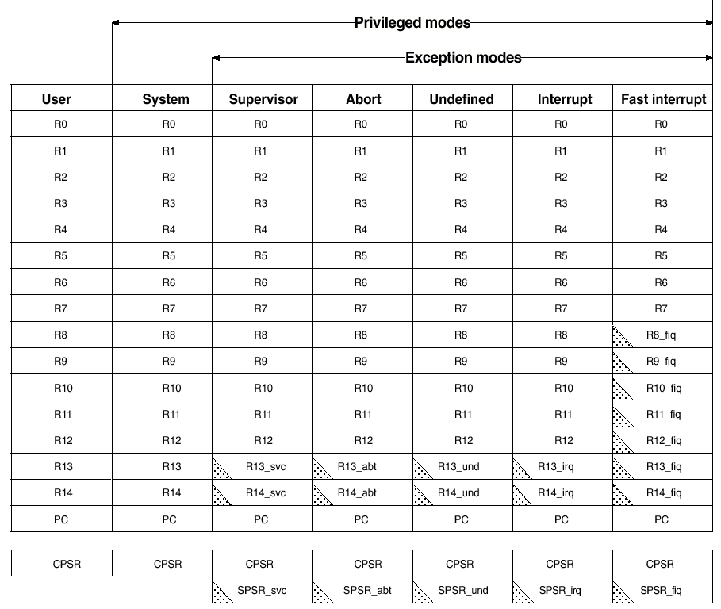
Register Map
Banked
register

Slide 41
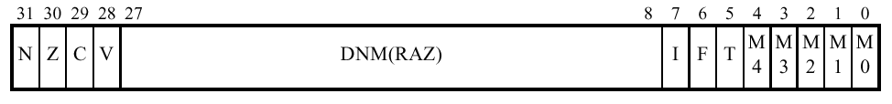
Program Status Register
Condition code : Negative (N), Zero (Z), Carry (C), Overflow (V)
I : IRQ disable
F : FIQ disable
T : Thumb mode
M[4:0] : operating mode,
User (10000), FIQ (10001), IRQ (10010),
Supervisor (10011), Abort (10111), Undefined (11011),
System (11111)

Slide 42
Exception of ARM
Reset
When reset input is asserted
Enter into Supervisor mode
Data Abort
Data access memory abort
By accessing invalid address
Can be used by MMU or MPU to set MMU control register.
FIQ
By asserting external FIQ input
Interrupt which minimizes the interrupt processing time
Because the exception vector entry for FIQ handler is located at the highest address, the handler can be loaded directly at the exception vector table entry without branching.
Additional banking of R8~R14.

Slide 43
Exception of ARM
IRQ exception
By asserting external IRQ input
Pre-fetch abort exception
Instruction fetch memory abort
Used to handle BKPT (breakpoint) instruction in v5T ISA.
Undefined exception
Any attempt to execute undefined instruction
Used for software emulation of coprocessor & extension of instruction set
Software interrupt exception
Execution of SWI instruction
Enter into supervisor mode
SWI type parameter : 24-bit in ARM mode, 8-bit in Thumb mode

Slide 44
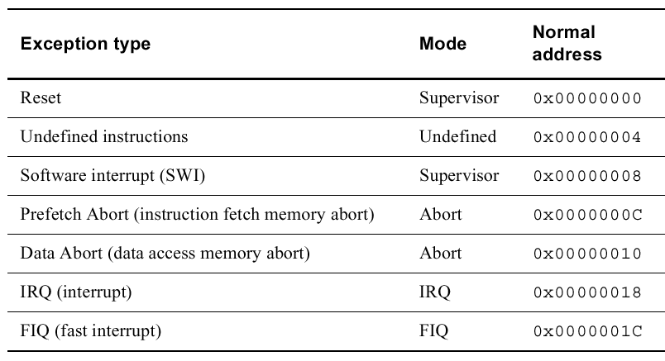
Exception of ARM
Recognition time of exception
The end of execution of the current instruction
Exception vector table

Slide 45
Procedure of Exception Handling
main()
woo()
ex_handler0()
ex_handler1()
Function call
Program memory
Nested exception
handler
exception
IRQ
Trap
Exception
vector
table
PC
0x 0000 0004
0x 0000 0000
JMP
Exception vector

Slide 46
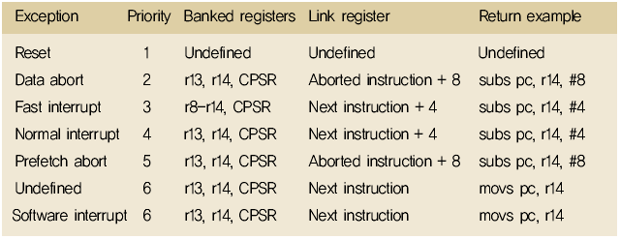
Exception Handling
Register changing
When exception occurs, r3, r14, CPSR are banked
The address value of link register depends on exception type
Before return, the return address should be adjusted

Slide 47
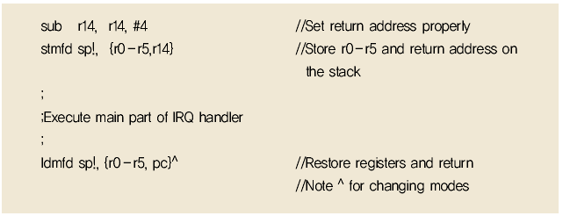
Exception Handling
Handler example

Slide 48
Memory Format
ARM processor supports Little-endian, Big-endian memory access.
Data type : byte (8-bit), Half-word (16-bit), word (32-bit)
Half-word : 2-byte boundary
Word : 4-byte boundary

Slide 49
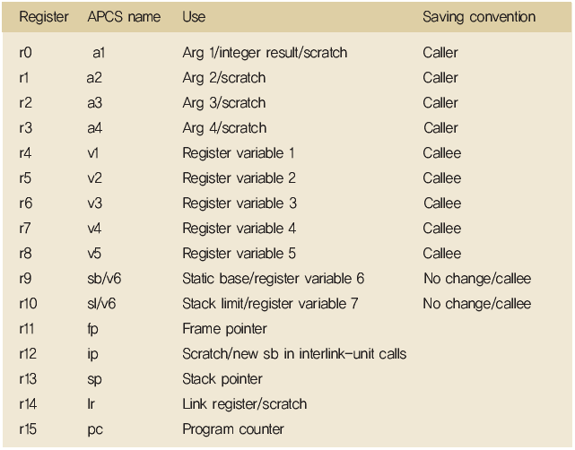
APCS (ARM Procedure Call Standard)
Compiler is recommended to follow APCS
The interface between HPL and assembly language keeps APCS

Slide 50
Linux

Slide 51
Operating System
Role of OS
Control & manage computing resource (CPU, memory, i/o).
Provide execution environment for application program
Support user interface : CLI, GUI
User space
App1
App2
App3
System Call Interface
Kernel space
Kernel Core
Device Driver
Hardware

Slide 52
Kernel of Operating System
Kernel
Essential part of operating system
Control computing resource & execute the command that user issued
Kernel component
Scheduler : share processor among multiple processes
Memory management system : manage process address space
Interrupt handler : service interrupt request
System service : networking, interprocess communication
Kernel architecture
Monolithic kernel
Micro kernel

Slide 53
Monolithic-kernel vs. Micro-kernel
System Service API
System Service API
1
2
n
1
2
n
Service Server
Integrated Kernel Architecture
Micro Kernel Architecture
Hardware
Hardware
(a) Monolithic kernel
(b) Micro kernel

Slide 54
Monolithic Kernel
Integrated all kernel functions into one kernel
Access kernel by calling kernel functions
Merit
Simple implementation
Manage system resources more effective
Demerit
Low portability
When kernel expands, increase kernel size & not easy to manage it
Introduce module concept
Sample OS
Unix (Solaris, HP-UX), Linux, Windows

Slide 55
Micro Kernel
Keep only essential functions in kernel and divide other kernel functions into several server modules
Merit
Easy to expand kernel function
High portability
Demerit
Complex to implement
Overhead of message passing between server modules
Low utilization of system resources
Sample OS
Cray UNICOS/mk, CMU Mach OS, Sunsoft Chorus, Digital UNIX, Linux Mk, Hurd

Slide 56
Kernel Components
Process management
Process generation & termination
Process communication : signal, pipe
CPU scheduling, synchronization
Access management of multiple processes on the limited resources.
Memory management
Virtual memory management
Effective memory hardware management by paging
Stable system by memory protection between processes
Network management
Support communication protocol
Network routing & address resolution
Manage network controller

Slide 57
Kernel Components
File system management
Support various file system by virtual file system (VFS)
Represent physical structure of hard disk with logical structure
File, directory management : normal file, device file, pipe
Manage buffer cache for block I/O
Device management
Verify & schedule I/O request
Data transfer between peripherals and memory
Manage device controllers
Handle interrupt request

Slide 58
Why Linux ?
No payment for use
GNU Public License
Save BOM (bill of materials) & development cost possibly
Many technical resources over internet
Kernel sources
documentations
know-how’s
Support from a lot of communities and volunteers
Free of technical supports
Demerit
No guarantees of quality of support
Originally designed for general-purpose, not for embedded (special purposed, real-time)

Slide 59
Features of Linux Kernel
Multi-tasking, multi-user system
based on time-division multi-plexing, multiple process can be executed, and multiple users can be logged on the same machine.
Symmetric multi-processor system
support multiple same kinds of processors in one machine.
Multi-platform
support various types of HW platform such as Intel IA-32, Alpha, Sparc, PowerPC, ARM, MIPS etc.
POSIX (portable operating system interface)
compatible with UNIX standard interface.

Slide 60
Features of Linux Kernel
Paging
assign & swap the memory in pages.
System-V IPC support
support System-V IPC such as semaphore, message queue, shared memory, etc.
Various types of file system support
support FAT, VFAT, NTFS, ISO9660, Joilet as well as the default file system, ext2
Various execution file-format support
a.out, ELF (executable and linking format).

Slide 61
Features of Linux Kernel
Networking
TCP/IP, IPX/SPX, Appletalk, SLIP (serial line IP), PPP. BSD socket.
Shared library
Provide the program codes common to application programs in the form of shared library.
Module
Add the device driver programs for new devices & new kernel functions dynamically to the existing kernel.
Support a lot of types of peripheral devices
Network card, video card, sound card, CD-ROM, SCSI, USB, PCMCIA, IrDA, etc.

Slide 62
Program Operating Mode
User mode
Normal program is executed in user address space
Kernel mode
Protected mode, privileged mode, supervisor mode
Control accesses on system resource
Exception handling
Mode change
Change user mode to kernel mode
By system call, exception
User Mode
System Call &
Interrupt
(trap, IRQ)
Kernel Mode

Slide 63
Kernel Source
Source tree of Linux kernel
LINUX
fs
init
arch
mm
net
kernel
drivers
lib
lpc
include
ext
mips
inet
net
Modules
linux
ext2
alpha
unix
char
asm-alpha
xiafs
sparc
block
asm-i386
lsofs
ppc
scsi
hpfs
sound
asm-m88k
nfs
i386
asm-generic
proc
kernel
asm-mips
minix
boot
asm-sparc
msdos
mm
sysv
math-emu
unsdos

Slide 64
Kernel Source
Documentation
Header files
include/linux : common header file for Linux kernel
include/asm : architecture-dependent header file, symbolic link
Architecture-independent source
init : kernel booting related. Initialization code.
kernel : essential part of kernel such as process management, timer, interrupt, signal, module, etc
ipc : inter-process communication. Pipe, signal, socket, message passing, shared memory
fs : file-system management source
net : network related source
drivers : device driver source
lib : library function. In kernel, standard C library is not used.

Slide 65
Kernel Source
Architecture-dependent source
arch/i386/boot
arch/i386/kernel
arch/i386/mm
arch/i386/lib
arch/i386/math-emu
if the floating-point coprocessor is not used, emulator related source
Source tree of kernel is different slightly on versions or packages

Slide 66
Linux Kernel Image
Kernel image
Execution file of Linux kernel
vmlinux
Uncompressed kernel image
zImage
Compressed kernel image under 1MB
bzImage
Compressed kernel image
Vmliux + initialization code (bootsect.S, setup) + bzImage attribute information

Slide 67
Example of Kernel Compile
Download kernel source
www.kernel.org : kernel source, patch file, ex) linux-2.4.0.tar.gz
> cd /usr/src
> rm –f linux
> tar zxvf linux-2.4.0.tart.gz
> mv linux linux-2.4.0
> ln –s lnux-2.4.0 linux
(patching)
> gzip –cd patch-2.4.1.gz | patch –p0

Slide 68
Example of Kernel Compile
Kernel source directory : /usr/src/linux
Kernel configuration
Dependency check and generate kernel image & module
> make config / menuconfig / xconfig
> make dep
> make zImage
> make modules
> make modules_install

Slide 69
Kernel Booting
Diskette booting
LILO (linux loader) booting
> dd if=bzimage of=/dev/fd0
> rdev –R /dev/fd0 /dev/hda1
> cp arch/i386/boot/bzimage /boot/vmlinuz-2.4.0
> cp system.map /boot/System.map-2.4.0
> vi /etc/lilo.conf
(editing)
image = /boot/vmlinuz-2.4.0
label=linux-2.4.0
root=/dev/hda1
read-only

Slide 70
Cross-Development Environment

Slide 71
ARM Development Tools
RVDS (RealView Development Suite) 4.0
Commercial tools provided by ARM
RVCT : RealView Compilation Tool
IDE : ARM Workbench
RealView ICE / Multi-ICE
RealView ARMulator
TRACE32-ICD
Commercial JTAG debugger for ARM, provided by Lauterbach, Germany
GNU tool-chain
Compiler (gcc), C-library (glibc), binary utility (binutils)
JTAG dongle
Flash memory fusing

Slide 72
Cross-Development
Cross-Development
Development machine != Execution machine
Development machine → host computer
Execution machine → target board
Procedure of cross-development
Setup cross-development environment
Preparing OS
Developing device driver if need
Programming application

Slide 73
Detailed X-development Procedure
Detailed procedure for ARM + Linux platform
Preparing cross-development environment
Tool-chain : editor, compiler, debugger
Flash memory fusing : JTAG
Preparing OS
Customizing boot loader
Reconfiguring Linux kernel
Creating or updating file system
Memory file-system : ramdisk
flash file-system
Developing device driver
Module programming
Building up application program
Install middle-ware if need

Slide 74

Development Environment Setup
Host computer
Edit, compile, debug the software for target board
Target board
What we want to build
Connection between host computer & target board
Serial port : connect target board’s consol port to host computer
JTAG : program download & debug
Ethernet : networking, file transfer, file system sharing
Serial
JTAG
Ethernet

Slide 75


Host Computer Setup
Host computer provides software development environment for target board
Development tools installed in host computer
Terminal emulator
Tool-chain : editor, cross-compiler, debugger
BOOTP server, TFTP server, NFS server
HUB
Ethernet
Terminal Emulator
Serial
Tool-chain
JTAG
BOOTP Server
TFTP Server
Target Board
NFS Server
Host Computer (LINUX)

Slide 76
Terminal Emulator
Terminal emulator
The program installed in host computer, which implements the functions of terminal using serial communication
Play the role of the monitor & keyboard of target board console
File upload & download
Hyper-terminal (Windows), minicom (Linux)
Serial interface program
Terminal Emulator
Console
Console
Port
File Upload
Serial
Port
File Download
Target Board
Host Computer

Slide 77
BOOTP Server
bootp (Boot Protocol)
Autobooting protocol of diskless client over IP network
Use UDP protocol
Assign IP address of target board through IP network
In Bootloader
# bootp
BOOTP Server
Bootp
Request
packet
daemon | Configuration file
xinetd | /etc/services /etc/xinetd.conf /etc/xinetd.d/bootp
bootpd | /etc/bootptab /etc/hosts
TCP
/IP
TCP
/IP
IP address
Target Board
Host PC

Slide 78
TFTP Server
TFTP (Trivial File Transfer Protocol)
Simple file transfer protocol using UDP
Fast download of large data file (kernel image, ramdisk image, applicaions)
Bootloader
#tftp [file_name]
TFTP Server
RRQ
TCP
/IP
TCP
/IP
xinetd | /etc/services /etc/xinetd.conf /etc/xinetd.d/tftp
in.tftpd | /tftpboot
Kernel, ramdisk,
Target Board
Host PC

Slide 79
NFS Server
NFS (Network File System)
File-system sharing via network
Provide storage space to target board
Direct execution of cross-compiled result without trasnfering it to target board
HUB
HUB
/mnt
Network File System
/nfs_resource
Target Board
Host Computer
NFS client
NFS server

Slide 80
Tool Chain
Tool chain
A group of tools for the developments of system program & application program
Text editor (vi), compiler (gcc), assembler (gas), linker (ld), utility programs (binutils), libraries (glibc)
Types of compilation
Native compile : the processor executing compiler is same as the prcessor executing compiled result (executable file)
Cross compile) : the processor executing compiler is different from the prcessor executing compiled result (executable file)
Compilation in embedde system development
Cross compile

Slide 81
Cross Tool Chain for ARM
Tool | Description
arm-linux-gcc | C compiler
arm-linux-c++ | C++ compiler
arm-linux-as | GNU assembler
arm-linux-gasp | GNU assembly preprocessor
arm-linux-ld | GNU linker
arm-linux-ar | Archives generation & modification
arm-linux-objdump | Get information about object file
arm-linux-nm | Display symbol information of objective file
arm-linux-strip | Delete symbol information from objective file
arm-linux-objcopy | Copy objective file
arm-linux-ranlib | Generate archive index
arm-linux-size | Display the size of sections of objective file
arm-linux-strings | Display strings & printable characters
arm-linux-addr2line | Translate address into file name and line number

Slide 82
Make Utility
Utility program which compile efficiently multiple files
Control the sequence of compilation
Manage the location of program installation
“Makefile”
Script file defining the compile procedure of make utility
Consist of dependencies & rules

Slide 83
Make Utility
(Makefile)
all: myapp
CC = gcc
INSTDIR = /usr/local/bin
CFLAGS = -g –Wall
myapp: main.o foo.o boo.o
$(CC) –o myapp main.o foo.o boo.o
main.o : main.c myhead.h
$(CC) $(CFLAGS) –c main.c
foo.o: foo.c foohead.h
$(CC) $(CFLAGS) –c foo.c
boo.o: boo.c boohead.h
$(CC) $(CFLAGS) –c boo.c
clean:
rm main.o foo.o boo.o

Slide 84
GDB : GNU Debugger
GDB
Text-based GNU debugger
Default Linux debugger
How to use
Use “–g” option when comple
Execute GDB command “gdb [object_file_name]”
GDB commands
run, backtrace, help, print, list, quit, break, clear, display, commnads, info, cont

Slide 85
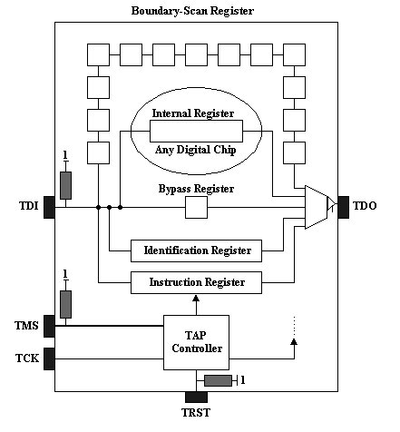
JTAG
JTAG
Joint Test Access Group’s boundary scan for PCB and chip test
1990 : adopted as IEEE 1149.1 standard
5-pin interface
TDI : test data in
TDO : test data out
TCK : test clock input
TMS : test mode select
TRST : test reset

Slide 86
JTAG Registers - 1
Identification register
32-bit, JTAG ID code
0 : Constant, ‘1’ if ID register exists
1..11 : Manufacturer ID, “000 0000 1001”
12..27 : Part Number, “1001 0010 0110 0001”
28..31 : Stepping, “xxxx”

Slide 87
JTAG Registers - 2
Instruction register
4-bit, 5-bit (for SA1110), holding instruction
1111 : BYPASS, TDI + Bypass + TDO
00110 : IDCODE, TDI + ID register + TDO
00011 : SAMPLE, TDI + boundary cells + TDO, sampling internal signals
01001 : INTEST, TDI + boundary cells + TDO, internal test
00000 : EXTEST, TDI + boundary cells + TDO, external test
00101 : HIGHZ, external output pins = high-Z
Bypass register : 1-bit

Slide 88
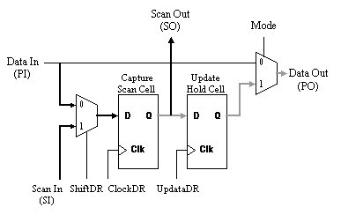
Boundary Scan Register
Boundary scan register
PI : parallel input
PO : parallel output
SI : serial input
SO : serial output

Slide 89
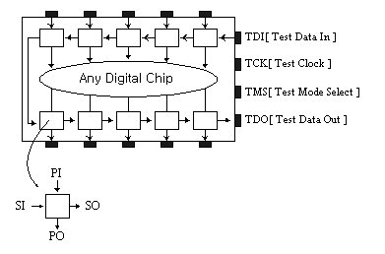
Boundary Scan Chain
Chain of boundary scan registers

Slide 90
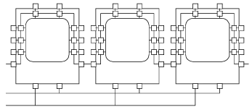
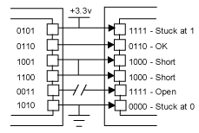
External Connection of JTAG
External connection
External connectivity test

Slide 91
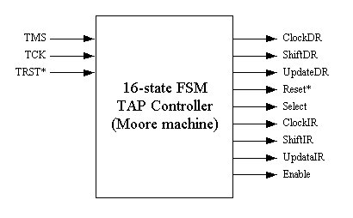
TAP Controller
TAP controller : FSM that controls JTAG interface
TMS is used to change state of TAPC

Slide 92
TAP Controller
States of TAP controller
Test-Logic-Reset : initialize TAPC
Run-Test/Idle : ready to test
Select DR-scan : connect scan cells
Capture DR : capture the data of PI
Shift DR : shift the data of scan cell, output to SO
Update DR : output to PO
Select IR-Scan : select IR
Capture IR : output PI of IR to shift cell
Shift IR : shift out the content of IR
Update IR : output to PO

Slide 93
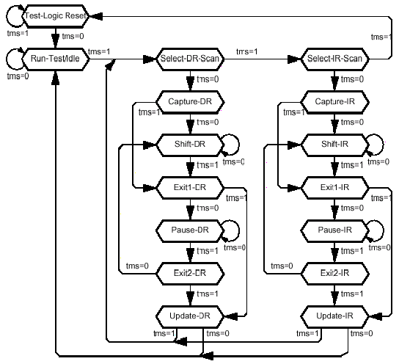
State Transition Diagram of TAPC

Slide 94
Flash Fusing
In-system flash memory fusing
Programmed using JTAG
Flash program utility : jflash
Example of flash memory map
User space (/usr)
0x90 0000 – 0xa160 0000
RAMdisk
0x0020 0000 ~
kernel (0x10 0000)
0x000c 0000 ~ 0x001c 0000
Env. Values (0x10 0000)
0x0008 0000 ~ 0x000c 0000
Boot loader
0x0000 0000 ~

Slide 95
Flash Fusing
Target Board
Host Computer
DRAM
TFTP
command
boot loader
TCP/IP
kernel
Jflash cmd
ramdisk
JTAG
Parallel
port
User Space

Slide 96
Bootloader

Slide 97
What happened before main() ?
Preparing execution environment of main()
Setup interrupt vector table
Initialize the hardware components
Load execution image (code, data)
Preparing C-execution
Set stack pointer properly
Call main()
C runtime libarary
crt0, crt1, …
Startup Code
Bootloader

Slide 98
Bootloader
Bootloader
The first program after system reset.
System initialization
Loading operating system into main memory
Characteristics of bootloader for embedded system
Specific to a target OS
Operate on flash memory
Support commands for system development
setip, bootp, tftp, flash, etc.

Slide 99
Bootloader
Function of bootloader
Hardware initialization
CPU clock, memory interface, i/o port setting, network setting
Memory copy
From flash memory to RAM
bootloader, kernel image, ramdisk image
Supporting bootloader commands
Booting OS kernel

Slide 100
Bootloader
Procedure of bootloader
start.S (assembly) → main.c (C language)
Start.S
Interrupt vector table setting
CPU setting
GPIO setting
Setup memory interface
Copy bootloader itself from flash memory to RAM
Stack pointer setting
Handover control to bootloader in RAM

Slide 101
Bootloader
main.c
Initialize serial port (console)
Initialize Ethernet port
Copy kernel image & ramdisk image from flash to RAM
Select booting mode (command mode or auto-boot)
In command mode, handle the commands typed-in

Slide 102
Operation Flow of Sample Bootloader
Set Interrupt handler
Interrupt masking
ICMR (0x9005_0004) = 0x00
Prevent entering sleep mode
PMCR (0x9002_0000) = 0x00
CPU clock setting
PPCR (0x9002_0014) = 0x0A
Setup GPIO
GPDR (0x9004_0004) = 0x0000_00FF
GPSR (0x9004_0008) = 0x0000_00FF
GRER (0x9004_0010) = 0x0000_0200
GFER (0x9004_0014) = 0x0000_0000
Setup SDRAM parameters

Slide 103
Operation Flow of Sample Bootloader
Call BeforeMain
Copy bootloader itself to main memory.
Call CMain function
Call CMain
Set baud rate of serial port & download speed
Initialize the timer & Ethernet interface
Wait key-stroke
Any key-stroke : enter bootloader command mode
No key-stroke : auto-booting

Slide 104
Source of Sample Bootloader (start.S)
.text
// vector table
// Reset = 0x0000 0000
// Undefined instruction = 0x0000 0004
// Software interrupt = 0x0000 0008
// Abort prefetch = 0x0000 000C
// Abort data = 0x0000 0010
// Not used = 0x0000 0014
// IRQ = 0x0000 0018
// FIQ = 0x0000 001C
.globl _start
_start: b reset
b undefined_instruction
b software_interrupt
b abort_prefetch
b abort_data
nop
b irq
b fiq
start.s

Slide 105
Source of Sample Bootloader
reset:
// All interrupt disable. mask ALL interrupts.
// ICMR (interrupt control mask register) = 0x9005 0004
// IM[31:0] = ICMR[31:0], 0 (masked), 1 (enabled)
mov r1, #0x90000000
add r1, r1, #0x50000
mov r2, #0x00
str r2, [r1, #0x4]
// Protect enterting sleep mode
// PMCR(power management control register) = 0x9002 0000
// SF-bit = PMCR[0]
// 0 (Don't force invocation of sleep mode)
// 1 (Force invocation of sleep mode)
mov r1, #0x90000000
add r1, r1, #0x20000
mov r2, #0x00
str r2, [r1, #0x00]

Slide 106
Source of Sample Bootloader
// PPCR(power manager PLL configuration register) = 0x9002 0014
// CPU clock = 206 MHz
// CCF 4..0 = PPCR[4:0]
// 00000 = 59.0 MHz, 00001 = 73.7 MHz, 00010 = 88.5 MHz
// 00011 = 103.2 MHz, 00100 = 118.0 MHz, 00101 = 132.7 MHz
// 00110 = 147.5 MHz, 00111 = 162.2 MHz, 01000 = 176.9 MHz
// 01001 = 191.7 MHz, 01010 = 206.4 MHz, 01011 = 221.2 MHz
mov r1, #0x90000000
add r1, r1, #0x20000
mov r2, #0x0a
str r2, [r1, #0x14]

Slide 107
Source of Sample Bootloader
// GPDR(GPIO Pin Direction Register) = 0x9004 0004
// PD[27:0] = GPDR[27:0]
// 0 (input), 1 (output)
#define GPIO_DIRECTION 0x0000 00ff
mov r2, #0x90000000
add r2, r2, #0x40000
ldr r1, =GPIO_DIRECTION
str r1, [r2, #0x04]
// GPSR (GPIO pin output set register) = 0x9004 0008
// PS[27:0] = GPSR[27:0]
// 0 (low), 1 (high)
ldr r3, =GPIO_DIRECTION
str r3, [r2, #0x08]

Slide 108
Source of Sample Bootloader
// GRER - (GPIO Rising-Edge Detect Register) = 0x9004 0010
// RE[27:0] = GRER[27:0]
// 0 (Disable), 1 (set GEDR bit high when rising edge is detected)
ldr r3, =0x00000200
str r3, [r2, #0x10]
// GFER (GPIO Falling-Edge Detect Register) = 0x9004 0014
// FE[27:0] = GFER[27:0]
// 0 (disable), 1 (set GEDR bit high when falling edge is detected)
mov r3, #0x00000000
str r3, [r2, #0x14]
// Set Dynamic Memory.
// DRAM configuration register (MDCNFG) = 0xA000 0000
// MDCAS00 (DRAM CAS waveform rotate register 0 for
DRAM bank pair 0/1) = 0xA000 0004
// MDCAS20 (DRAM CAS waveform rotate register 0 for
DRAM bank pair 2/3) = 0xA000 0020
// MDCAS01 = 0xA000 0008, MDCAS02 = 0xA000 000C
// MDCAS21 = 0xA000 0024, MDCAS22 = 0xA000 0028
// MDCASn0[31:0] = 0xAAAA AA7F
// MDCASn1[31:0] = 0xAAAA AAAA
// MDCASn2[31:0] = 0xAAAA AAAA

Slide 109
Source of Sample Bootloader
// MDREFR.KnDB2 = 0
// (SDRAM)
// RAS-to-CAS delay = 8 * CPU-clock-period
// CAS-to-CAS delay = 2 * CPU-clock-period
// Delay from SDCLK rising edge to read data
// latching edge = 3* CPU-clock-period
mov r1, #0xA0000000
ldr r2, =0xAAAAAA7F
str r2, [r1, #0x04]
str r2, [r1, #0x20]
ldr r2, =0xAAAAAAAA
str r2, [r1, #0x08]
str r2, [r1, #0x24]
ldr r2, =0xAAAAAAAA
str r2, [r1, #0x0C]
str r2, [r1, #0x28]
// MDREFR (DRAM refresh control register) = 0xA000 001C
// 0 (SLFRSH, KAPD, EAPD, K2DB2, K2RUN, K0RUN, E0PIN)
// 1 (K1DB2, K1RUN, E1PIN, K0DB2)
// DRI[11:6] = 0, DRI[5:4] = 1, DRI[3:2] = 0, DRI1 = 1, DRI0 = 0
// TRASR[3:0] = 0111
ldr r2, =0x00740327
str r2, [r1, #0x1C]

Slide 110
Source of Sample Bootloader
// MDCNFG (DRAM configuration register) = 0xA000 0000
ldr r2, =0x725c7245
str r2, [r1, #0x00]
// Issue read requests to disabled bank to start refresh.
ldr r1, =0xC0000000
.rept 8
ldr r0, [r1]
.endr
// LED 0 on
// GPIO clear register = GPCR : 0x9004 000c
mov r1, #0x90000000
add r1, r1, #0x40000
ldr r2, =0x00000001
str r2, [r1, #0x0C]
// Set Static Memory.
// MSC0(Static memory control register 0) = 0xA000 0010
// MSC1(Static memory control register 1) = 0xA000 0014
// MSC2(Static memory control register 2) = 0xA000 002C
// SMCNFG(SMROM configuration register) = 0xA000 0030
// MECR (Expansion bus configuration register) = 0xA000 0018

Slide 111
Source of Sample Bootloader
mov r1, #0xA0000000
ldr r2, =0x4b944b90
str r2, [r1, #0x10]
ldr r2, =0x4b954b94
str r2, [r1, #0x14]
ldr r2, =0x00004b95
str r2, [r1, #0x2C]
ldr r2, =0xafccefcc
str r2, [r1, #0x30]
ldr r2, =0x994a994a
str r2, [r1, #0x18]
// Led 1 on
mov r1, #0x90000000
add r1, r1, #0x40000
ldr r2, =0x00000002
str r2, [r1, #0x0C]
// SDRAM Clear
#define DRAM_BASE_ADDR (0xc0000000)
#define DRAM_SIZE (0x02000000) // 32MB

Slide 112
Source of Sample Bootloader
ldr r1, =DRAM_BASE_ADDR
mov r2, #0x00000000
ldr r3, =DRAM_BASE_ADDR
add r3, r3, #DRAM_SIZE
1:
str r2, [r1]
add r1, r1, #4
cmp r1, r3
bne 1b
// Led 2 on
mov r1, #0x90000000
add r1, r1, #0x40000
ldr r2, =0x00000004
str r2, [r1, #0x0C]
// Set stack pointer
ldr sp, =STACK_POINT

Slide 113
Source of Sample Bootloader
// Jump to the C code.
jump_to_c:
b BeforeMain
// handler setting
undefined_instruction:
b undefined_instruction
software_interrupt:
b software_interrupt
abort_prefetch:
b abort_prefetch
abort_data:
b abort_data
not_used:
b not_used
irq:
b irq
fiq:
b fiq

Slide 114
Source of Sample Bootloader (main.c)
typedef struct {
long terminalSpeed;
long downloadSpeed;
} LOADER_STATUS;
LOADER_STATUS status;
void BeforeMain(void);
void CMain(void);
bool DoPrintfHelp(int argc, char **argv);
#define LOADER_SRAM_BASE (0x00000000)
#define LOADER_DRAM_MAX_SIZE (0x00010000)
#define DRAM_SIZE (0x02000000)
#define LOADER_DRAM_BASE
(DRAM_BASE_ADDR+DRAM_SIZE-LOADER_DRAM_MAX_SIZE)
void BeforeMain(){
register ulong *dest = (ulong *)LOADER_DRAM_BASE;
register ulong *src = (ulong *)LOADER_SRAM_BASE;
register ulong len = LOADER_DRAM_MAX_SIZE / 4;
void (*JumpTo)(void);
while (len--) *dest++ = *src++;
JumpTo = CMain;
JumpTo();
return;
}

Slide 115
Source of Sample Bootloader
void CMain( ){
int i;
bool autoboot=true;
char cmd[128];
long timeout;
int argc=0;
char *argv[MAX_ARGS];
CMD_TBL *cptr;
#define SERIAL_SPEED 1
#define SERIAL_DOWNLOAD_SPEED 1
// 191 : 1200
// 23 : 9600
// 11 : 19200
// 5 : 38400
// 3 : 57600
// 1 : 115200
status.terminalSpeed = SERIAL_SPEED;
status.downloadSpeed = SERIAL_DOWNLOAD_SPEED;
SerialInit(status.terminalSpeed);
TimerInit();
#ifdef USE_LCD_LOGO
ViewLogo();
#endif

Slide 116
Source of Sample Bootloader
// ethernet initialization
EthInit(); // scc.c
// wait 10 seconds before starting autoboot.
printf("Autoboot in progress, press any key to stop ");
for (i=0; i<DELAY_BEFORE_BOOT; i++){
timeout = GetTime() + HZ; // 1초간 Delay
printf(".");
while (GetTime()<timeout){
// 시리얼포트로 입력이 있으면 입력값은 무시하고 수동부트 모드
if (UTSR1 & UTSR1_RNE){
UTDR;
autoboot = false;
break;
}
}
if (autoboot==false) break;
}

Slide 117
Source of Sample Bootloader
// No key was pressed, proceed booting the kernel.
if (autoboot){
printf("Autoboot started.\n");
printf("\nkernel loading...");
MemCpy(
(char *)KERNEL_DRAM_BASE,
(char *)KERNEL_SRAM_BASE,
KERNEL_MAX_SIZE);
printf("Done");
printf("\nramdisk loading...");
MemCpy(
(char *)RAMDISK_DRAM_BASE,
(char *)RAMDISK_SRAM_BASE,
RAMDISK_MAX_SIZE);
printf("Done");
for (cptr=cmdTbl; cptr->cmd; cptr++){
if (!StrCmp(cptr->cmd, "boot")) break;
}
DoBootKernel(cptr, 1, 0);
}

Slide 118
Source of Sample Bootloader
// Key was pressed, proceed command mode.
printf("\nAutoboot aborted\n");
printf("Type \"help\" to get a list of commands\n");
// the command loop. endless, of course.
for(;;) {
DisplayPrompt(NULL);
// wait an hour to get a command.
GetCommand(cmd, 128, 3600);
if (!cmd || !cmd[0]) continue;
argc = GetArgs(cmd, argv);
for (cptr=cmdTbl; cptr->cmd; cptr++){
if (!StrCmp(argv[0], cptr->cmd)){
(cptr->run)(cptr, argc, argv);
break;
}
}
if (!StrCmp(argv[0], "help") || !StrCmp(argv[0], "?")){
DoPrintfHelp(argc, argv);
} else if (!(cptr->cmd)){
printf("\tUnknown command : %s\n", argv[0]);
}
}
} // The end of CMain

Slide 119
Source of Sample Bootloader (command.c)
bool DoBootKernel(CMD_TBL *cptr, int argc, char **argv){
#ifndef TINY_LOADER
long addr;
#endif
long opt[2];
void (*theKernel)(int zero, int arch);
if (argc!=1 && argc!=3 && argc!=4){
printf(cptr->usage);
return false;
}
switch (argc){
case 1 : // boot
opt[0] = 0; opt[1] = 0x14;
// KERNEL_DRAM_BASE = 0xC000 8000
theKernel = (void (*)(int, int))KERNEL_DRAM_BASE;
break;
case 3 :
(생략)
printf("\nStarting kernel ...\n\n");
theKernel(opt[0], opt[1]);
return true;
}

Slide 120
Kernel Configuration

Slide 121
Configuration Options
Code maturity level options
Prompt for development and/or incompleter code/drivers
Loadable module support
enable loadable module support
System type
(SA1100-based) ARM system type - SA11x0 implementations, include support for TBEL1110
General setup
support hot-pluggable devices
Networking support
System V IPC : +18KB
Sysctl support

Slide 122
Configuration Options
General setup
NWFPE math emulation
kernel core (/proc/kcore) format (ELF/a.out)
kernel support for ELF binaries** : +13 KB.
Timer and CPU usage LEDs
Timer LED
CPU usage LED
Kernel-mode alignment trap handler

Slide 123
Configuration Options
Block devices
Loopback device support**
RAM disk support
Default RAM disk size (8192)
Initial RAMS disk (initrd) support
Flash memory block device support
Networking options
packet socket**
Unix domain sockets**
TCP/IP networking

Slide 124
Configuration Options
Network device support
Network device support
Ethernet (10 or 100Mbit) → Ethernet (10 or 100 Mbit)**
PPP (point-to-point protocol) support**
PPP support for async serial ports**
PPP deflate compression**
PPP BSD-compress compression
Character devices
Virtual terminal
SA1100 serial port support
Console on SA1100 serial port
Serial console 115200
Unix98 PTY support

Slide 125
Configuration Options
File systems
/proc file system support
/dev/pts file system for Unix98 PTYs
Second extended fs support**
Network file systems → NFS file system support : +27KB.
Kernel hacking
Verbos kernel error message
Verbose user fault messages
Kernel low-level debugging functions

Slide 126
File System

Slide 127
Linux File System Architecture
User process
User process
User process
User mode
System Call Interface
Kernel mode
Virtual File System Switch (VFS)
proc
ext2
msdos
minix
Buffer Cache
Device Drivers
Disk Controller

Slide 128
File System Structure
Each file is represented by a data structure, called an inode.
Inode : File type, access rights, owners, timestamps, size, pointers to data blocks, link counter

Slide 129
File System Structure
Directory : structured in a hierarchical tree, contains files and subdirectories
A file containing a list of entries which contains inode number & file name
Link
Hard link : used only within a single file system. Can only point on files.
Symbolic link : file containing a filename. Does not point to an inode. Cross-filesystem symoblic link is possible.

Slide 130
File System Structure
Device special file
devices can be accessed via special file. Does not use disk space. Access point to the device driver.
Character special file
I/O operations in character mode
Block special file
I/O operations in block mode via a buffer cache function.
I/O request on special file
forwarded to device driver. Referenced by major number (device type) & minor number (device unit)

Slide 131
Virtual File System Switch (VFS)
VFS
Abstraction layer between application program and filesystem
Provides system calls for file management
Maintains internal data structures and pass task on to actual file system
Common interface to various filesystem

Slide 132
Virtual File System Switch (VFS)
Filesystem supported by VFS
Disk-based filesystem : manage memory space of local disk parition
EXT2, MS-DOS, VFAT, NTFS, ISO9660 CD-ROM
Network-based filesystem : access the filesystem belongs to other computer in network.
NFS, Coda, AFS, SMB, NCP
Special filesystem (virtual filesystem) : no use of disk space
/proc : provide the interface for user to access data structure of kernel
/dev/pts : support pseudo-terminal of Open Group’s UNIX 98 standard

Slide 133
/Proc File System
Provide the information on the status of kernel and running processes
Inodes for /proc
Root : 1
Others : defined in <linux/proc_fs.h>
Directory structure
/proc/pid : holding informtion on process-pid
/proc/loadavg : provide average system load for the last 1, 5, 15 minutes
/proc/uptime : indicates time in seconds since system start and the time used by idle process
/proc/meminfo : contains the number of total, used and free bytes of main memory and swap area
/proc/kmsg : supplies kernel messages which have not been read viad syslog system call
/proc/version : kernel version information
/proc/cpuinfo : parameters of the processor
/proc/pci : occupation of PCI slots
/proc/self/ : information about the process accessing /proc file system
/proc/scsi/ : information about SCSI devices
/proc/malloc : monitoring of kmalloc(), kfree()
/proc/kcore : core dump of kernel

Slide 134
/Proc File System
Directory structure (continued)
/proc/net/ : files that describe Linux network layer
unix : information on opened Unix domain sockets
arp : contents of ARP table
route : routing table
dev : available network devices
raw : information about opened RAW sockets
tcp : information about TCP sockets
uDP : information about UDP sockets
snmp : MIB (Management Information Bases) for SNMP protocol
sockstat : statistics about the sockets
/proc/modules : information about modules loaded, size and status
/proc/stat : Linux kernel statistics
/proc/devices : information about registered device drivers
/proc/interrupts : the number and names of hardware interrupt received.
/proc/filesystems : existing file system of kernel
/proc/ksyms : all symbols exported by kernel
/proc/dma : DMA channel information

Slide 135
/Proc File System
Directory structure (continued)
/proc/sys/ : information controlling kernel algorithms
kernel
domainname : system domain name
filemax : max # of simultaneously opened files
filenr : # of currently opened files
hostname : computer name
inodemax : max # of simultaneously opened inodes
inodenr : # of currently opened inodes
osrelease : kernel version
ostype : operting system name
panic : timeout after a panic message
securelevel : security level
version : compiler information during kernel compilation
net/ : depends on network configuration
vm/ : control parameters of memory management processes
bdflush : control parameters of bd_flush process
freepages : value of free-page levels
kswapd : control parameters of kswap daemon
swapctl : control parameters of swap process

Slide 136
/Proc File System
Directory structure (continued)
/proc/ioports : I/O ports occupied via request_region()
/proc/smp : information on CPUs in SMP systems
/proc/cmdline : command line passed to kernel at startup
/proc/mtab : list of currently mounted file systems
/proc/md : statistics on usage of multiple device driver (CONFIG_BLK_DEV_MD configured)
/proc/rc : RTC values (CONFIG_RTC configured)
/proc/locks : current file locks

Slide 137
Linux File System
Minix : 1987, the first file-system of Linux
EXT (extended file system) : 1992. 4, v0.96c
EXT2 : 1993, improved EXT file-system
EXT3 : 2001.11, v.2.4.15, journaling file-system
EXT4 : 2008.12, v2.6.28, pre-allocation, delayed-allocation
 | Minix | Ext | Ext2 | EXT3 | EXT4
Max. FS Size | 64M | 2G | 4T | 32T | 1E
Max. File Size | 64M | 2G | 2G | 2T | 16T
Max. File Name | 14 | 255 | 255 | 254 | 256
Variable Block Size | X | X | 1K~8K

Slide 138
Ext2 File System Structure
Physical structure of filesystem
Structure of block group
Boot Sector
Block Group 1
Block Group 2
... ...
Block Group N
Super Block
Group Descriptors
Block Bitmap
Inode Bitmap
Inode Table
Data Blocks

Slide 139
Ext2 File System Structure
Block group descriptor (32-bytes)
Directory
Managed using singly linked list
Date structure of directory entry
0
7
Block bitmap |  | Inode bitmap
Inode table |  | # of free blocks | # of free inodes
# of directories | Pad words
struct ext2_dir_entry {
unsigned long inode; // inode number
unsigned short rec_len; // length of directory entry
unsigned short name_len; // length of filename
char name[EXT2_NAME_LEN]; // filename
};

Slide 140
Ext2 File System Structure
Inode (128 bytes)
0
7
Type/Permission | UID | File size
Access time |  | Time of creation
Time of modification |  | Time of deletion
GID | Link counter | # of blocks
File attributes |  | Reserved
1st direct block
….
12-th direct block
1-stage indirect block |  | 2-stage indirect block
3-stage indirect block |  | File version
File ACL (access control list) |  | Directory ACL
Fragment address |  | Reserved

Slide 141
EXT2 Library and Tools
Libext2fs : allow user to manipulate the control structure of Ext2 filesystem
Filesystem-oriented operations
Directory-oriented operations
Inode-oriented operations
Tools
tune2fs : modify filesystem parameters
e2fsck : repair filesystem consistencies after unclean shutdown
Phase-1 : inode check
Phase-2 : directory check
Phase-3 : directory connectivity check
Phase-4 : reference count (link count) check for all inodes
Phase-5 : check the validity of filesystem summary information
debugfs : examine and change the state of filesystem

Slide 142
Ramdisk
Ramdisk device
Use a part of main memory as hard disk
/dev/ram0, /dev/ram1
Ramdisk image
File having ramdisk or file system image mounted with “–o” loop option
Ramdisk object
ELF object file having ramdisk image (generally compressed)

Slide 143
Loop Device
Loop device
Virtual device which use a file as file system
/dev/loop0, /dev/loop1
Initial ramdisk device
Use loop device as root file system
After executing /linuxrc program on ramdisk, the file system on the other device is mounted as root file system.
Even after changing root file system, initial ramdisk device can be accessed through /dev/initrd device.

Slide 144
Ramdisk Generation
dd if=/dev/zero of=/tmp/fsfile bs=1K count=1000
/sbin/losetup /dev/loop0 /tmp/fsfile
/sbin/mke2fs /dev/loop0
mkdir /mnt/tmp
mount –t ext2 /dev/loop0 /mnt/tm
cd /mnt/tmp
ls

Slide 145
Module Programming

Slide 146
Module
Object code (xxx.o) which can be dynamically linked to kernel.
Loading & removing during executing kernel
Event-driven, not sequential processing
Module is executed in kernel mode
Application of module : device driver, file system, network protocol stack

Slide 147
Kernel Programming
Not use standard C library
due to speed & size, too large & inefficient for the kernel
Programmed in GNU C, not in strict ANSI C
Inline function : inline
Inline assembly : embedding of assembly instructions
Branch annotation : likely/unlikely
static inline void fooba (…) {…}
asm (….);
if (unlikely(foo))
……
if (likely(foo))
……

Slide 148
Kernel Programming
No memory protection in kernel
No use of floating point
Small, fixed size stack : 8KB
Synchornization/Concurrency is critical
due to multiprocessing, asynchronous interrupt request, preemptive
Portability

Slide 149
Module Programming
Careful for using global variables because the global variables used in module affect the kernel.
Careful for accessing memory because there is no limitation on memory access.
Translate the floating arithmetic into the floating arithmetic.
Careful for using data array & recursive call because the size of kernel stack is limited.
Do not use processor-specific code for portability. Word size and order of storing data (endian) should be considered.

Slide 150
Module Programming
Interfaces between application, kernel and hardware
Address space
System
Call
command
Application
return
Kernel
IRQ
H/W
1G
Kernel Address Space
PAGE_OFFSET
0xC000 000
3G
User Address Space

Slide 151
Module Programming
Message output function to standard output device : same as printf function
For code efficiency, standard C library can not be used in kernel / module.
Input/output device function
printk(LOG_LEVEL const char *pstr);
// LOG_LEVEL : KERN_EMERG, KERN_ALERT, KERN_ERR,
KERN_WARNING, KER_INFO, KERN_DEBUG
// byte-based
unsigned inb (unsigned ioport);
unsigned outb (char value, unsigned ioport);
void insb(unsigned ioport, void *addr, unsigned log count);
void outsb(unsigned ioport, void *addr, unsigned long count);
// halfword(16-bit), word(32-bit)-based
unsigned inw/inl (unsigned ioport);
unsigned outw/outl (char value, unsigned ioport);
void insw/insl(unsigned ioport, void *addr, unsigned log count);
void outsw/outsl(unsigned ioport, void *addr, unsigned long count);

Slide 152
Module Programming
Data transfer between user space and kernel space
Memory allocation
unsigned long copy_from_user(void *to, const void *from, unsigned long n);
unsigned long copy_to_user(void *to, const void *from, unsigned long n);
put_user(data, ptr); // the size of “data” depends on data type of “ptr”
get_user(ptr); // 1, 2, 4 bytes
// 128~128KB, contiguous physical memory allocation
void *kmalloc(unsigned int len, int priority);
void kfree(void *ptr);
// no limit in size, contiguous virtual memory allocation
void vmalloc(unsigned int len); // for virtual memory
void vmfree(void *ptr);
void *memset(void *s, char c, size_t count);

Slide 153
Module Programming
Interrupt related functions
Interrupt handler functions
cli(); // clear interrupt
sti(); // set interrupt
save_flags(unsigned long flag); // save status register
restore_flags(unsigned long flag); // restore status register
// interrupt handler registration
int request_irq(unsigned int irq_no, void(*handler)(int),
unsigned long flags, const char *device);
// interrupt handler release
void free_irq(unsigned int irq_no);

Slide 154
Module Programming
Synchronization
struct wait_queue {
struct tast_struct *task;
struct wait_queue *next;
};
void sleep_on(struct wait_queue **p);
void interruptible_sleep_on(struct wait_queue **p);
void wake_up(struct wait_queue **p);
void wake_up_interruptible(struct wait_queue **p);

Slide 155
Module Programming
Device driver handling functions
int register_chrdev(unsgined int major, const char *name, struct file_operations *fops);
int register_blkdev(unsgined int major, const char *name, struct file_operations *fops);
int register_netdev(struct net_device *dev);
int unregister_chrdev(unsgined int major, const char *name);
int unregister_blkdev(unsgined int major, const char *name);
int unregister_netdev(struct net_device *dev);

Slide 156
Module Programming
Data structure for module
struct module {
unsigned long size_of_struct; // sizeof(module)
struct module *next;
const char *name; // module name
unsigned long size; // module size
union { atomic_t usecount; // module usage counter
long pad; } uc;
unsigned long flags; // module flags
unsigned nsyms; // # of exported symbols
unsigned ndeps; // # of referenced modules
struct module_symbol *syms; // table of exported symbols
struct module_ref *deps; // list of referenced modules
struct module_ref *refs; // list of referencing modules
int (*init)(void); // initialization method
void (*cleanup)(void); // cleanup method
const struct exception_table_entry *ex_table_start; // start of exception table
const struct exception_table_entry *ex_table_end; // end of exception table
……
};

Slide 157
Module Programming
Module loading/unloading
<linux/init.h>
int init_module(void); // module loading
void cleanup_module(void); // module unloading
<linux/init.h>
#define module_init(x) int init_module(void) { return x(); }
#define module_exit(x) void cleanup_module(void) { x(); }

Slide 158
Module Programming
Usage count
Counting the number of processes using the module.
Checking whether the module is used or not.
Related macro
MOD_INC_USE_COUNT : usage count ++
MOD_DEC_USE_COUNT : usage count --
MOD_IN_USE : return TRUE if usage count is not equal to ‘0’
Information about symbols registered in symbol table
/proc/ksyms
address + symbol name + version number :
Ex) c0134a50 register_chardev_R1a5f156e

Slide 159
Module Programming
Template of module programming
#include <linux/kernel.h>
#include <linux/module.h>
#include <linux/init.h>
int module_start();
void module_end();
EXPORT_NO_SYMBOLS;
module_init(module_start);
module_exit(module_end);
int module_start() { …… }
int module_end() { …… }

Slide 160
Module Programming
Compile option
“c” option : Linker is not called because it will link to kernel directly
“Wall” option : check all errors and warnings.
“O” option : protect inline function from trying to make external link.
“D” option : define symbols and macros. __KERNEL__ (kernel symbol & macro), MODULE (module), LINUX (Linux related)
Usages
# gcc –c –O –Wall –DMODULE –D__KERNEL__ -DLINUX hello.c

Slide 161
Version Checking
Make sure that kernel version and module version is same.
Kernel version data of module
kernel_version[] in <linux/module.h>
Kernel version in kernel itself
LINUX_VERSION_CODE in < linux/version.h>
Ex) ver 1.3.5 : 0x10305 (66309), ver 2.4.0 : 0x20400 (132096)
<linux/module.h>
#include <linux/version.h>
static const char __module_kernel_version[] __attribute__((section(".modinfo"))) =
"kernel_version=" UTS_RELEASE;
<linux/version.h>
#define UTS_RELEASE "2.4.0-test5-rmk1-np1"
#define LINUX_VERSION_CODE 132096

Slide 162
Version Checking
Macro for kernel version checking
KERNEL_VERSION (vers, rel, seq)
vers << 16 | rel << 8 | seq
Dependency checking example
<linux/version.h>
#define KERNEL_VERSION(a,b,c) (((a) << 16) + ((b) << 8) + (c))
#ifdef LINUX_KERNEL_CODE <= KERNEL_VERSION(2,4,0)
….do something under ver 2.4.0…….
#else
….do something over ver 2.4.0…….
#endif

Slide 163
Shell Commands for Module
/sbin/insmod
Link dynamically to kernel, Require root privilege
/sbin/rmmod
Remove module from kernel
/sbin/lsmod
Check state of module
Same as /proc/modules file
/sbin/depmod
Check dependency of module
/sbin/modprobe
Load module and its dependent modules
/sbin/modinfo
Display information about the module

Slide 164
Communication between Module and User
Using /dev file system
Using /proc file system
Virtual file system having information about kernel
How to communicate with module using /proc file system
Generate new file under /proc directory.
Use file operation to access /proc file system.
File registration to /proc file system : create_proc_entry ()
File deletion from /proc file system : remove_proc_entry ()

Slide 165
Data Entry Structure of /proc
Data entry structure (proc_dir_entry)
Define the characteristics of pseudo file generated under /proc directory after module generation.
struct proc_dir_entry = {
unsigned short low_ino; // inode value of file
unsigned short name_len; // length of file name
const char *name; // file name generated
mode_t mode; // file access mode
…
struct inode_operation *proc_iops; // file operation
read_proc_t *read_proc; // file pointer for reading
write_proc_t *write_proc; // file pointer for writing
…
};

Slide 166
Registration &Deletion of /proc Entry
Registration of /proc entry
create_proc_entry()
Deletion of /proc entry
remove_proc_entry()
#include <linux/proc_fs.h>
struct proc_dir_entry (*create_proc_entry)(const char *name, mode_t mode, struct proc_dir_entry *parent)
name : filename
mode : access right for file
parent : location of file generated (if /proc, then NULL)
void remove_proc_entry(const char *name, struct proc_dir_entry *parent)

Slide 167
Read & Write of /proc
Function pointer read_proc for reading, write_proc for writing of proc_dir_entry
#include <linux/proc_fs.h>
struct proc_dir_entry *ent;
int proc_read (char *buf, char **start, off_t off, int count, int *eof, void *data);
int init_module() {
ent = create_proc_entry (myfile, S_IRUGO, NULL);
if (ent != NULL) ent->read_proc = proc_read;
}
void cleanup_module() {
remove_proc_entry(myfile, NULL);
}
int proc_read(char *buf, char **start, off_t off, int count, int *eof, void *data) {
int len;
len = sprintf(buf, “hello ! \n”);
return len;
}

Slide 168
Device Driver

Slide 169
Linux System Architecture
Application
System call interface
Virtual Filesystem Switch (VFS)
Network subsystem
Buffer cache
Character
device driver
Block
device driver
Network
device driver
Device interface
Hardware

Slide 170
Device Access Mode
Polling mode
Periodical checking the status of input/output operation
Interrupt mode
Cheking the status of input/output operation by using interrupt
Process
(I/O Request)
Process
(I/O Request)
User
Space
Call
Call
Blocked
Return
Return
Resumed
Kernel
Space
Device driver
Device driver
ret_from_sys_call
→ Bottom half
→ Scheduler
Cmd
Status
Polling
Cmd
Status
Device
IRQ
Device
ISR
Polling Mode I/O Operation
Interrupt Mode I/O Operation

Slide 171
Device Driver
Device driver
Consists of data structures & functions used to control I/O devices.
Device access by user : use the file name of /dev file system
Device access by kernel : use device driver & major number & minor number of device.
Upper 8-bit of “i_dev” variable of device file = major number
Lower 8-bit of “i_dev” = minor number.
Advantages of device driver
Unified interface of kernel to various types of devices.
By capsulizing the program code specific to devices as module, it is easy to optimize the kernel size by loading and deleting it dynamically.
It is easy to add the device : Device manufacturer can add new device without understanding in detail about kernel source code

Slide 172
Device Driver
Major number
Interger (0 ~ 255)
Same major number for same device driver
Major number of device in use
include/linux/major.h or /proc/devices
Minor number
Integer (0 ~ 255)
Identify the devices whose major number is same.

Slide 173
Device Type
Character device
Sequential access in character-base, not use buffer cache.
Can be accessed by calling system calls (open, close, read, write)
Reference = “c”
Can not use seek system call.
Serial port, console port, mouse, parallel port, etc
Block device
Random access in block-based, use buffer cache.
Reference = “b”
Ram disk, hard disk, cd-rom, etc

Slide 174
Device Type
Network device
Packet-based device
Can not map to a special file
Use packet transfer functions
socket(), bind(), listen(), accept(), connect()

Slide 175
Loading of Device Driver
Registration function : register_xxxdev() in <linux/fs.h>
int register_chrdev(unsigned int major, const char *name, struct file_operations *fops);
int register_blkdev(unsgined int major, const char *name, struct file_operations *fops);
int register_netdev(struct net_device *dev);
# cat /proc/devices
Character devices:
1 mem
2 pty
3 ttyp
4 ttyS
5 cua
…..
Block devices:
1 ramdisk
3 ide0
7 loop
#
- major : major number, if ‘0’, kernel allocates it dynamically
name : device name, /proc/devices.
fops : address of data structure of file operation related to device.

Slide 176
Device Table
Device table : store device driver name & funtion pointer to its file operations. Index = major number of device driver
#define MAX_CHRDEV 255
struct device_struct {
const char *name;
struct file_operations *fops;
};
static struct device_struct chardevs[MAX_CHRDEV];
#define MAX_BLKDEV 255
static struct {
const char *name;
struct block_device_operations *bdops;
} blkdevs[MAX_BLKDEV];
Device driver name
chardevs[255]
File operations
0
name
fops
open()
1
read()
2
254

Slide 177
Unloading of Device Driver
Deletion function : unregister_xxxdev()
Device file generation
int unregister_chrdev(unsgined int major, const char *name);
int unregister_blkdev(unsgined int major, const char *name);
int unregister_netdev(struct net_device *dev);
# mknod [device_file_name] [type] [major] [minor]
# mknod /dev/my_dev c 250 1

Slide 178
Usage Counter of Device Driver
Usage count : the number of usages of device driver
Macro for usage count : defined in <linux/module.h>
MOD_INC_USE_COUNT : increase current usage count by 1
MOD_DEC_USE_COUNT : decrease current usage count by 1
MOD_IN_USE : check whether current usage count is 0 or not
/proc/modules : information about modules in use
# cat /proc/modules
netlink 3180 -1 [ipv6]
floppy 45960 1 (autoclean)
monitor 516 0 (unused)
Referenced by ‘ipv6’
Managed by ‘kerneld’
Usage count is not used
Module name
Usage count
# of bytes used

Slide 179
File Operations for Device
Data structure of file operation : defined in <linux/fs.h>
struct file_operation {
struct module *owner;
loff_t (*lseek)(struct file *, off_t, int);
ssize_t (*read)(struct file *, char *, size_t, loff_t *);
ssize_t (*write)(struct file *, const char *, size_t, loff_t *);
int (*readdir)(struct file *, void *, filldir_t);
unsigned int (*poll)(struct file *, struct poll_table_struct *);
int (*ioctl)(strut inode *, struct file *, unsigned int, unsigned long);
int (*mmap)(struct file *, struct vm_area_struct *);
int (*open)(struct inode *, struct file *);
int (*flush)(struct file *);
int (*release)(struct inode *, struct file *);
int (*fsync)(struct file *, struct dentry *);
int (*fasync)(int, struct file *, int );
int (*check_media_change)(kdev_t dev);
int (*revalidate)(kdev_t dev);
int (*lock)(struct file *, int, struct file_lock *);
ssize_t (*readv)(struct file *, const struct iovec *, unsigned long, loff_t *);
ssize_t (*writev)(struct file *, const struct iovec *, unsigned long, loff_t *);
};

Slide 180
File Operations for Device
loff_t (*lseek)(struct file *, off_t, int);
relocate the position for reading/writing. loff_t = long long (64-bit)
ssize_t (*read)(struct file *, char *, size_t, loff_t *);
Reading data from device, return the number of bytes read.
ssize_t (*write)(struct file *, const char *, size_t, loff_t *);
Writing data to device.
int (*readdir)(struct file *, void *, filldir_t);
Reading directory information. Not used for device driver.
unsigned int (*poll)(struct file *, struct poll_table_struct *);
Insert current process into waiting queue.

Slide 181
File Operations for Device
int (*ioctl)(strut inode *, struct file *, unsigned int, unsigned long);
Call device-dependent control commands.
int (*mmap)(struct file *, struct vm_area_struct *);
Map device memory to process memory.
int (*open)(struct inode *, struct file *);
Initialize the device.
int (*flush)(struct file *);
Write data to device. Used in SCSI device.
int (*release)(struct inode *, struct file *);
Close device file. Retrun used memory space.
int (*fsync)(struct file *, struct dentry *);
Write all data in buffer to device.

Slide 182
File Operations for Device
int (*fasync)(int, struct file *, int );
Check the device whose FASYNC flas is changed.
int (*check_media_change)(kdev_t dev);
Only for block device. Used in removable device.
int (*revalidate)(kdev_t dev);
Manage buffer cache
int (*lock)(struct file *, int, struct file_lock *);
Lock the file
ssize_t (*readv)(struct file *, const struct iovec *, unsigned long, loff_t *);
Read data from the buffer
ssize_t (*writev)(struct file *, const struct iovec *, unsigned long, loff_t *);
Write data to the buffer.

Slide 183
Usage of File Operations for Device
struct file_operation dvi_fop ={
read : dvi_read,
write : dvi_write,
open : dvi_open,
release : dvi_release
};
ssize_t dvi_read() {
}
ssize_t dvi_write() {
}
int dvi_open() {
}
int dvi_release() {
}

Slide 184
Blocking I/O
IF device is busy, put the process requesting device access in waiting state till the device is available.
Waiting process
Wake-up process
Interruptible or not : when wake-up, handle the suspended interrupt during waiting state. For the critical part of kernel (wake_up), For device driver (wake_up_interruptible)
#include <linux/sched.h>
void interruptible_sleep_on(struct wait_queue **q);
void sleep_on(struct wait_queue **);
void wake_up_interruptible(struct wait_queue **q);
void wake_up(struct wait_queue **);

Slide 185
Blocking I/O
Waiting queue
Linked-list in Kernel 2.4
Header : wait_queue_head_t
Entry : wait_queue_t
Defining waiting queue before use it
Macro : DECLARE_WAIT_QUEUE_HEAD(wq)

Slide 186
Blocking I/O
#include <linux/sched.h>
static DECLARE_WAIT_QUEUE_HEAD (wq);
static ssize_t foo_read(struct file *filp, char *buf, size_t len, loff_t *offset) {
printk(KERN_DEBUG “process %d (%s) \n”, current->pid, current->comm);
interruptible_sleep_on(&wq);
printk(KERN_DEBUG “awoken %d (%s) \n”, current->pid, current->comm);
return 0;
}
static ssize_t foo_write(struc file *filp, const char *buf, size_t len, loff_t *offset) {
printk(KERN_DEBUG “process %d (%s) \n”, current->pid, current->comm);
wake_up_interruptible(&wq);
return count;
}

Slide 187
Interrupt Handler
Interrupt and its device : /proc/interrupts
Interrupt request & release function
Interrupt registration function
init_module or open
int request_irq(unsigned int irq, void (*handler)(int, void *, struct pt_regs *), unsgined long flags, const char *device, void *dev_id);
void free_irq(unsigned int irq, void *dev_id);
irq : interrupt number
(*handler) : interrupt handler
flags : bit mask for interrupt, -SA_INTERRUPT (fast interrupt),
-SA_SHIRQ (share IRQ among multiple devices)
*device : device name
*dev_id : if interrupt is shared, identify the device

Slide 188
Interrupt Handler
Interrupt handler can not exchange data with user space.
In case of normal interrupt, we have to handle other interrupts.
Role of interrupt handler
Remove interrupt pending bit of the device
Read data from kernel or write data to device for interupt handling
Wake up the waiting processes

Slide 189
EX-1 : Character Device Driver
#include <linux/kernel.h>
#include <linux/module.h>
#include <linux/init.h>
#include <linux/config.h>
#include <linux/sched.h>
#include <linux/string.h>
#include <linux/malloc.h>
#include <linux/delay.h>
#include <linux/errono.h>
#include <linux/types.h>
#include <asm/hardware.h>
#include <asm/uaccess.h>
#include <asm/irq.h>
#include <asm/param.h>
#include “Gpio_int.h”
#define END_OF_FILE -1
static DECLARE_WAIT_QUEUE_HEAD(device_wait_queue);
static int device_init(void);
static void device_exit(void);
static int device_open(struct inode *, struct file *);
static int device_release(struct inode *, struct file *);
static ssize_t device_read(struct file *, char *, size_t, loff_t *);
static ssize_t device_write(struct file *, const char *, size_t, loff_t *);
static int device_ioctl(struct inode *, struct file *, unsigned int, unsigned long);
static void gpio_irq_handler(int, void *, struct pt_regs *);
static unsigned int nfalling_edge;
static struct gpio_irq_stat *buffer_queue;
static int front, rear;

Slide 190
static struct file_operations device_fops = {
open : device_open,
read : device_read,
write : device_write,
ioctl : device_ioctl,
release : device_release };
static int device_init(void) {
if(register_chrdev(MAJOR_NUMBER, “gpio_int”, &device_fops) <0 ) {
printk(“Device registration failed \n”); return MAJOR_NUMBER;
}
printk(DEVICE_NAME “:device is with Major number = %d\n”, MAJOR_NUMBER); return 0;
static void device_exit(void) {
unregister_chrdev(MAJOR_NUMBER, “gpio_int”);
}

Slide 191
static int device_open(struct inode *inode, struct file *filp) {
int nRet;
buffer_queue = (struct gpio_irq_stat *) kmalloc (BIFFER_SIZE * sizeof(struct gpio_irq_stat),
GFP_KERNEL);
rear = front = 0;
nfalling_edge = 0;
GPDR &= ~(GPIO_GPIO0);
set_GPIO_IRQ_edge(GPIO_GPIO0, GPIO_FALLING_EDGE);
nRet = request_irq(IRQ_GPIO0, gpio_irq_handler, SA_INTERRUPT, “GPIO) IRQ”, (void *)0);
if(nRet) {
printk(“GPIO_interrupt : can’t get GPIO0 IRQ”); return -EAGAIN;
}
MOD_INC_USE_COUNT; return 0;
}
static int device_release(struct inode *inode, struct fiel *filp) {
kfree(buffer_queue);
free_irq(IRQ_GPIO0, (void *)0);
MOD_DEC_USE_COUNT; return 0;
}

Slide 192
static ssize_t device_read(struct file *filp, char *buf, size_t count, loff_t *fops) {
int nCopytoBuf = 0;
char pre_buf[1024];
int len = 0;
int I, nCnt;
if(!access_ok(VERIFY_WRITE, buf, count)) { printk(“buffer is empty\n”); return -EFAULT; }
memset(pre_buf, 0, 1024);
if(front == rear) {
printfk(“buffer is empty\n”);
if(flip->f_flags & O_NONBLOCK) return -EAGAIN;
else interruptible_sleep_on(&device_wait_queue);
}
if(front < rear) nCnt = rear - front;
else nCnt = rear + BUFFERSIZE - front;
for(I=0; I<nCnt; nCopytoBuf += len, I++) {
len = sprintf(pre_buf+nCopytoBuf, “irg=%d, jiffies=%ld, edge=%d\n”,
buffer_queue[front].bit_number, buffer_queue[front].irq_time,
buffer_queue[front].nfalling_edge_stat);
front = (front+1)% BUFFER_SIZE;
}
__copy_to_user(buf, pre_buf, nCopytoBuf); return nCopytoBuf;
}

Slide 193
static ssize_t device_write(struct file *filp, const char *buf, size_t count, loff_t *fops) {
int target_bit = 0;
unsigned long bitstate, flags;
save_flags(flags);
cli();
printk(“target bit : %d\n”, target_bit);
GPDR != GPIO_GPIO(target_bit);
bitstate = (GPLR & GPIO_GPIO(target_bit)) >> target_bit;
printk(“Value of %d (before toggle) : %ld\n”, target_bit, bitstate);
if(bitstate) {
printk(“Clear\n”);
GPCR = GPIO_GPIO(target_bit);
} else {
printk(“Set \n”);
GPSR = GPIO_GPIO(target_bit);
}
bitstate = (GPLR & GPIO_GPIO(target_bit)) >> target_bit;
printk(“Value of %d (after toggle) : %ld\n”,target_bit,bitstate);
restore_flags(flags);
GPDR &= ~(GPIO_GPIO(target_bit));
return count;
}

Slide 194
static void gpio_irq_handler(int irq, void *dev_id, struct pt_regs *regs) {
nfalling_edge++;
if(front == (rear+1) %BUFFER_SIZE) {
printk(“Buffer is full \n”); return;
} else {
buffer_queue[rear].bit_number = irq;
buffer_queue[rear].irq_time = jiffies;
buffer_queue[rear].nfalling_edge_stat = nfalling_edge;
rear = (rear+1) % BUFFER_SIZE;
}
wake_up_interruptible(&device_wait_queue);
}
EXPORT_NO_SYMBOLS;
module_init(device_init);
module_exit(device_exit);

Slide 195
int main() {
int fd;
fd = open(“/dev/gpio_int”,O_RDWR);
gpio_read(fd);
gpio_write(fd);
}
Void gpio_read(int fd) {
len = read(fd, str, 1024);
}
Void gpio_write(int fd) {
len = write(fd, (int *)1,sizeof(int));
}

Slide 196
Ex-2 : Device Driver for LED
Step-1 : Memory map 확인
(include/asm-arm/mach/map.h)
struct map_desc {
unsigned long virtual;
unsigned long physical;
unsigned long length;
int domain:4,
port_read:1,
port_write:1,
cacheable:1,
bufferable:1;
};

Slide 197
(arch/arm/mm/map-sa110.c) → arch/arm/mach-sa1100/generic.c, lart.c
#define SA1100_STD_IO_MAPPING \
/* virtual physical length domain r w c b */ \
{ 0xe0000000, 0x20000000, 0x04000000, DOMAIN_IO, 1, 1, 0, 0 }, /* PCMCIA0 IO */ \
{ 0xe4000000, 0x30000000, 0x04000000, DOMAIN_IO, 1, 1, 0, 0 }, /* PCMCIA1 IO */ \
{ 0xe8000000, 0x28000000, 0x04000000, DOMAIN_IO, 1, 1, 0, 0 }, /* PCMCIA0 attr */ \
{ 0xec000000, 0x38000000, 0x04000000, DOMAIN_IO, 1, 1, 0, 0 }, /* PCMCIA1 attr */ \
{ 0xf0000000, 0x2c000000, 0x04000000, DOMAIN_IO, 1, 1, 0, 0 }, /* PCMCIA0 mem */ \
{ 0xf4000000, 0x3c000000, 0x02000000, DOMAIN_IO, 1, 1, 0, 0 }, /* PCMCIA1 mem */ \
{ 0xf8000000, 0x80000000, 0x02000000, DOMAIN_IO, 0, 1, 0, 0 }, /* PCM */ \
{ 0xfa000000, 0x90000000, 0x02000000, DOMAIN_IO, 0, 1, 0, 0 }, /* SCM */ \
{ 0xfc000000, 0xa0000000, 0x02000000, DOMAIN_IO, 0, 1, 0, 0 }, /* MER */ \
{ 0xfe000000, 0xb0000000, 0x02000000, DOMAIN_IO, 0, 1, 0, 0 } /* LCD + DMA */
static struct map_desc tbel1110_io_desc[] __initdata = {
#ifdef CONFIG_SA1100_TBEL1110
{ 0xd0000000, 0x00000000, 0x01000000, DOMAIN_IO, 1, 1, 0, 0 }, /* Flash bank 0 */
{ 0xd8000000, 0x18000000, 0x00800000, DOMAIN_IO, 1, 1, 0, 0 }, /* Ethernet */
SA1100_STD_IO_MAPPING
#endif
};

Slide 198
-> check kernel space & user space
(include/asm-arm/arch-sa1100/memory.h)
/* Page offset: 3GB */
#define PAGE_OFFSET (0xc0000000UL)
PAGE_OFFSET 의 위는 kernel space (1GB), 아래는 user space (3GB) 로 사용.

Slide 199
Step-3 : Device driver programming
#include <linux/ioport.h>
#include <asm/uaccess.h>
#include <linux/module.h>
#include <linux/fs.h>
#include <asm/io.h>
#define LEDPORT_MAJOR 0
#define LEDPORT_NAME “LED PORT”
#define LEDPORT_MODULE_VERSION “V1.0”
#define LEDPORT_ADDR 0xf1600000
#define LEDPORT_ADDR_RANGE 1
static int ledport_usage = 0;
static int ledport_major = 0;

Slide 200
int ledport_open(struct inode *minode, struct file *mfile) {
if(ledport_usage !=0) retrun –EBUSY;
MOD_INC_USE_COUNT;
ledport_usage = 1;
return 0;
}
int ledport_release(struct inode *minode, struct file *mfile) {
MOD_DEC_USE_COUNT;
ledport_usage = 0;
return 0;
}
ssize_t ledport_write_byte(struct fille *inode, const char *gdata, size_t length,
loff_t *off_what) {
unsigned char *addr;
unsigned char c;
get_user(c, gdata);
addr = (unsigned char *)(LEDPORT_ADDR);
*addr = c;
return length;
}

Slide 201
static struct file_operations led_fops = {
write : ledport_write_byte,
open : ledport_open,
release : ledport_release,
};
int init_module(void) {
int result;
result = register_chrdev(LEDPORT_MAJOR, LEDPORT_NAME, &led_fops);
if(result <0) {
printk(KERN_WARNING”can’t get any major \n);
return result;
}
ledport_major = result;
if(check_region(LEDPORT_ADDR,LEDPORT_ADDR_RANGE))
request_region(LEDPORT_ADDR,LEDPORT_ADDR_RANGE,LEDPORT_NAME);
else
printk(KERN_WARNING”Can’t get IO region 0x%x\n”,LEDPORT_ADDR);
printk(“init module, ledport major number : %d\n”,result);
return 0;
}

Slide 202
void cleanup_module(void) {
release_region(LEDPORT_ADDR, LEDPORT_ADDR_RANGE);
if(unregister_chrdev(ledport_major,LEDPORT_NAME))
printk(KERN_WARNING”%s driver cleanup failed \n”,LEDPORT_NAME);

Slide 203
Step-4 : Test program
#include <stdio.h>
#include <stdlib.h>
#include <unistd.h>
#include <sys/types.h>
#include <sys/stat.h>
#include <fcntl.h>
int main(int argc, char **argv) {
int dev;
char buff;
if(argc <= 1) {
printf(“please input parameter \n”); return –1;
}
dev = open(“/dev/ledport”,O_WRONLY);

Slide 204
if(dev != -1) {
if(argv[1][0]==‘0’)&&(argv[1][1]==‘x’||argv[1][1]==‘X’))
buff = (unsigned char)strtol(&argv[1][2],NULL,16);
else
buff = atoi(argv[1]);
write(dev, &buff, 1);
close(dev);
} else {
printf(“Device open ERROR\n”); exit(-1);
}
return 0;
}

Slide 205
Makefile Generation
(Makefile)
CC = arm-linux-gcc
KERNLEDIR = /usr/local/linux
INCLUDEDIR = -l$(KERNELDIR)/include –l./
CFLAGS = -D__KERNEL__ -DMODULE –Wall –O2 –l$(INCLUDEDIR)
MODULE_OBJS = ledport.o
MODULE_SRCS = ledport.c
TEST_TARGET = test
TEST_OBJS = test.o
TEST_SRCS = test.c
All: $(MODULE_OBJS) $(TEST_TARTGET)
$(MODULE_OBJS) :
$(CC) $(FLAGS) –c $(MODULE_SRCS)
$(TEST_TARGET) : $(TEST_OBJS)
$(CC) $(CFLAGS) $(TEST_OBJS) –o $@

Slide 206
Compile & Execution
$ make
; ledport.o, test.o, test file generation
$ insmod ledport.o
Using ledport.o
init module, ledport major number : 253
$ mknod /dev/leport c 253 0
; special device file generation
$ ./test 0xaf
; execution

Slide 207
Q&A

